Slide 1
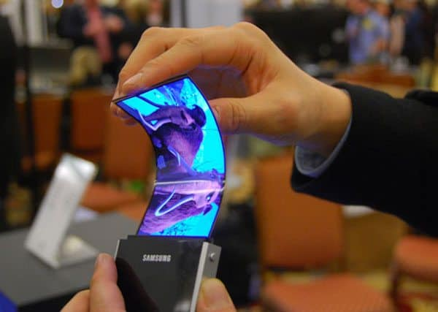
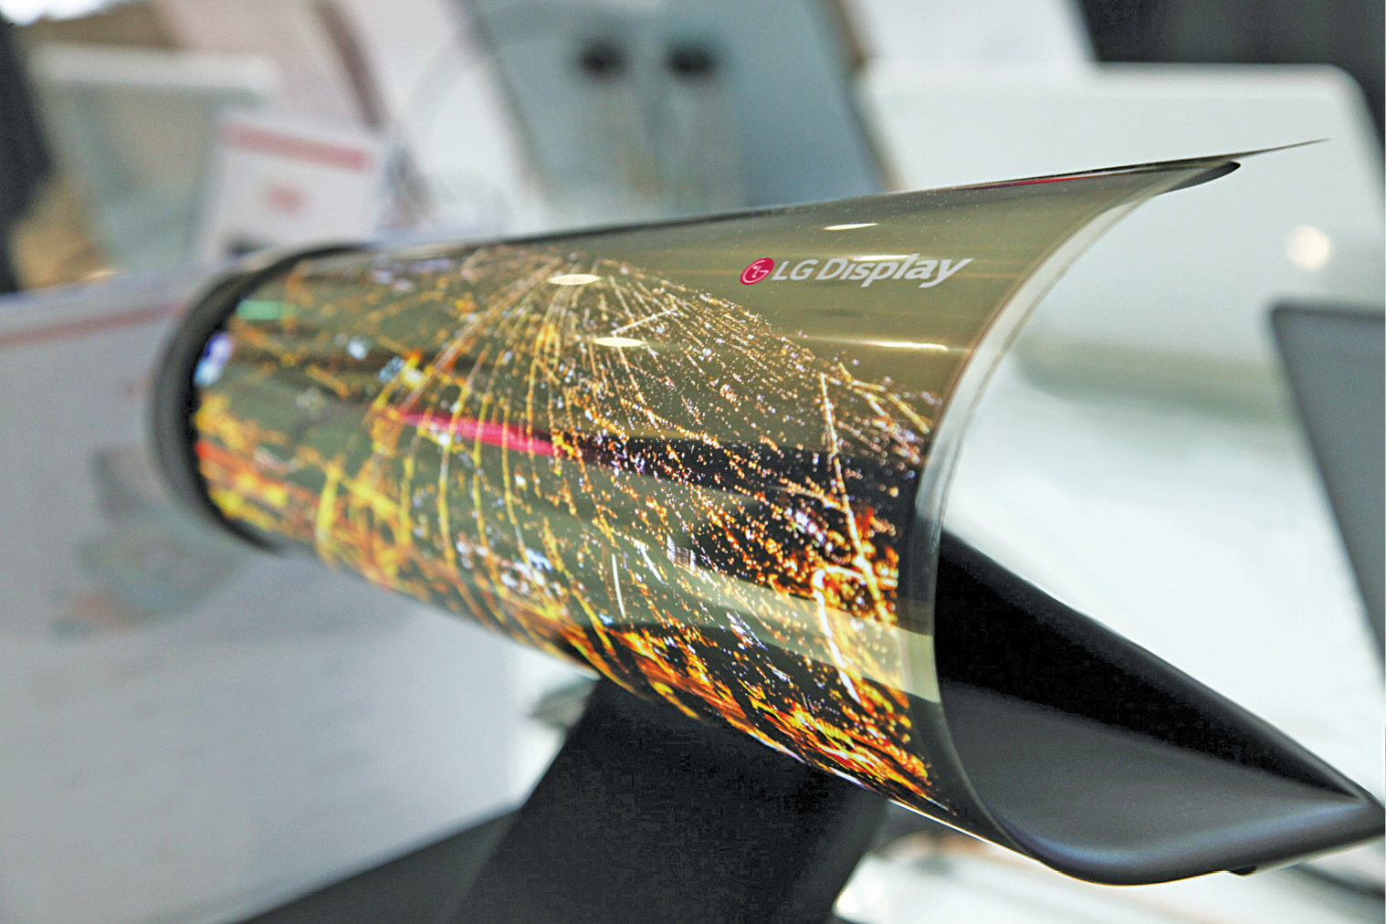
BHARATI VIDYAPEETH DEEMED UNIVERSITY COLLEGE OF ENGINEERING PUNE
DEPARTMENT OF ELECTRONICS AND TELECOMMUNICATION ENGINEERING
"OLED"
Guided By :-
Prof. PD Kadam
By :- PRN No:-
Krishna Mani Raj 1814110507

Slide 2
Introduction :-
OLED stands for organic light emitting diode(OLED).
OLED are solid state device that creates light based on electricity.
Main principle behind OLED technology is electroluminescence.
Offers brighter, thinner, high contrast, flexible displays.
Samsung is leader in OLED Display technology.

Slide 3
Parameters of OLED
It has excellent contrast.
It has no motion blur.
It has wide viewing angle (upto 170').
It has low power consumption.
It has very good brightness and sharpness.

Slide 4
Working principle of OLED
A simple OLED is made up of six layers.
A voltage is applied across the anode and cathode.
Current flows from cathode to anode through the organic layers.
Electrons flow to emissive layer from the cathode.
Electrons are removed from conductive layer leaving holes.
Holes jump into emissive layer .
Electron and hole combine and light emitted.

Slide 5
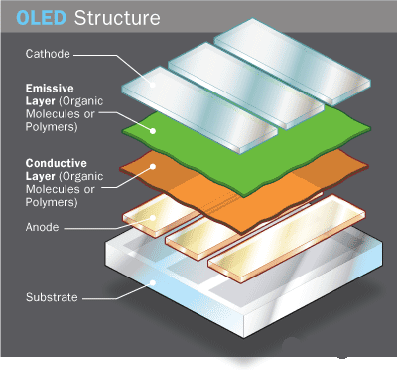
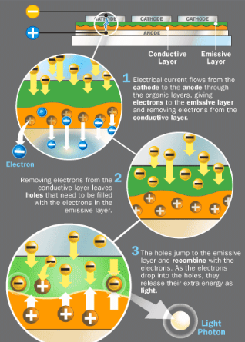
WORKING PRINCIPLE (FIGURE)

Slide 6
TYPES OF OLED
Six types of OLEDs :-
Passive matrix OLED(PMOLED).
Active matrix OLED(AMOLED).
Transparent OLED(TOLED).
Top emitting OLED.
Flexible OLED(FOLED).
White OLED(WOLED).

Slide 7

Advantages of OLED display over LCD display
1. Contrast Ratio
Higher contrast ratio than LCD display.

Slide 8
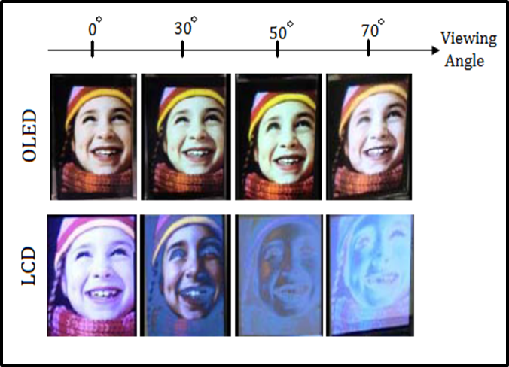
2.Viewing Angle
Higher viewing angle up to 170° for constant contrast ratio.

Slide 9
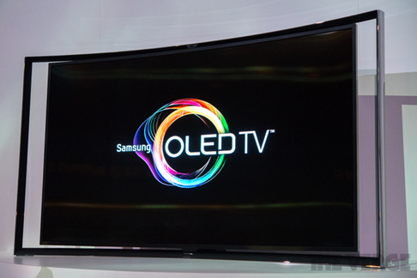
application of oled:-
1.OLED TV

Slide 10


2.Mobile phones with OLED Screen

Slide 11
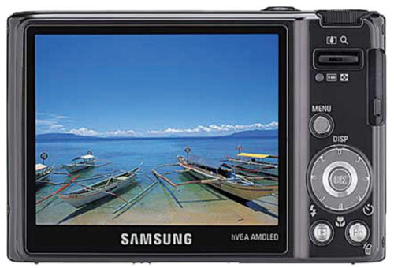
3. Digital camera with OLED screen

Slide 12
THANK YOU

